Slide 1
Generative AI
CSCI 4360/6360 Data Science II

Slide 2
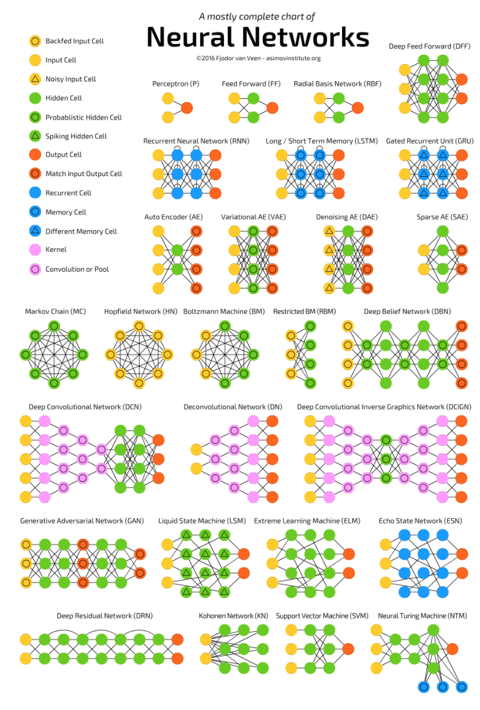
The Neural Network Zoo
http://www.asimovinstitute.org/neural-network-zoo/

Slide 3
The Neural Network Zoo
http://www.asimovinstitute.org/neural-network-zoo/
Today

Slide 4
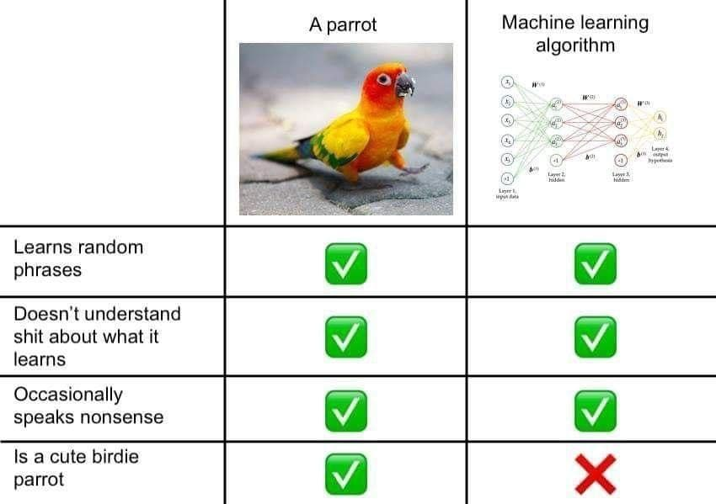
Caveat Emptor

Slide 5
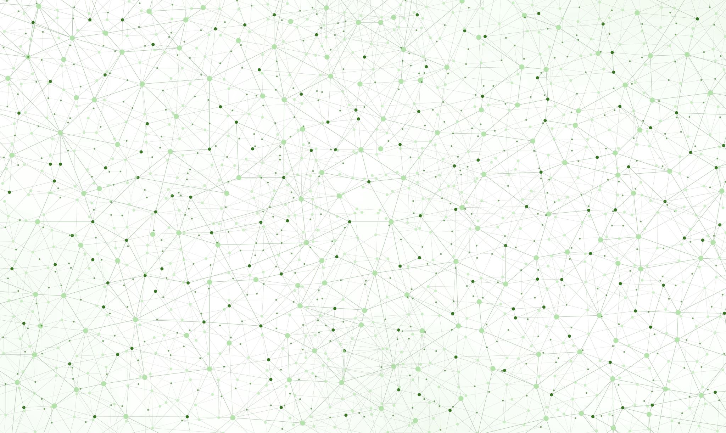
What are generative models?

Slide 6
What is a “generative model”?
Discriminative
Logistic Regression
Support Vector Machines
Random Forests
Generative
Gaussian Naïve Bayes
Variational Autoencoders
Adversarial Networks
P(Y | X)
P(X, Y) and P(Y)

Slide 7
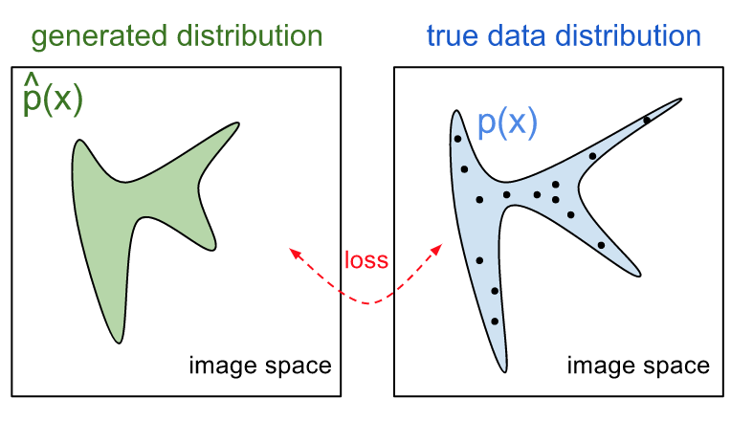
Generative Models

Slide 8
Generative Models

Slide 9
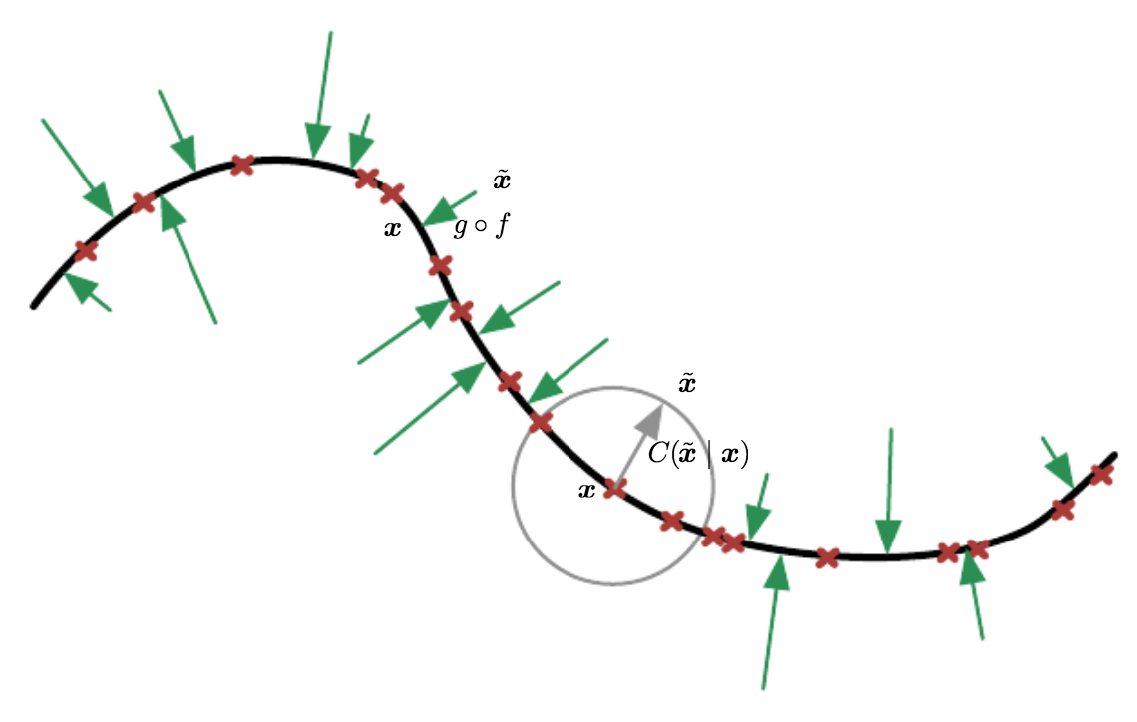
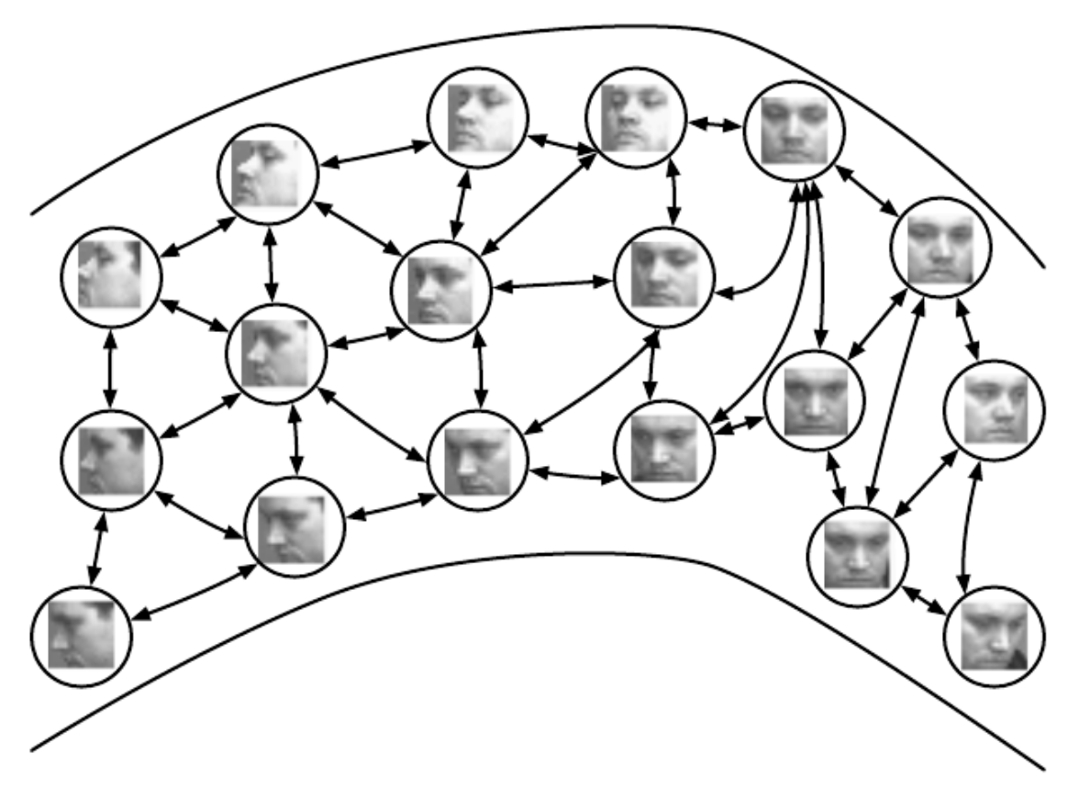
Generative Models
Learning a distribution or manifold
Statistical notion of how the data were generated
P(X) asks: how likely is the data point X?
If likely -> X was generated by this process
Compare to P(Y), which asks: how likely is the label?
If likely -> X has label Y

Slide 10
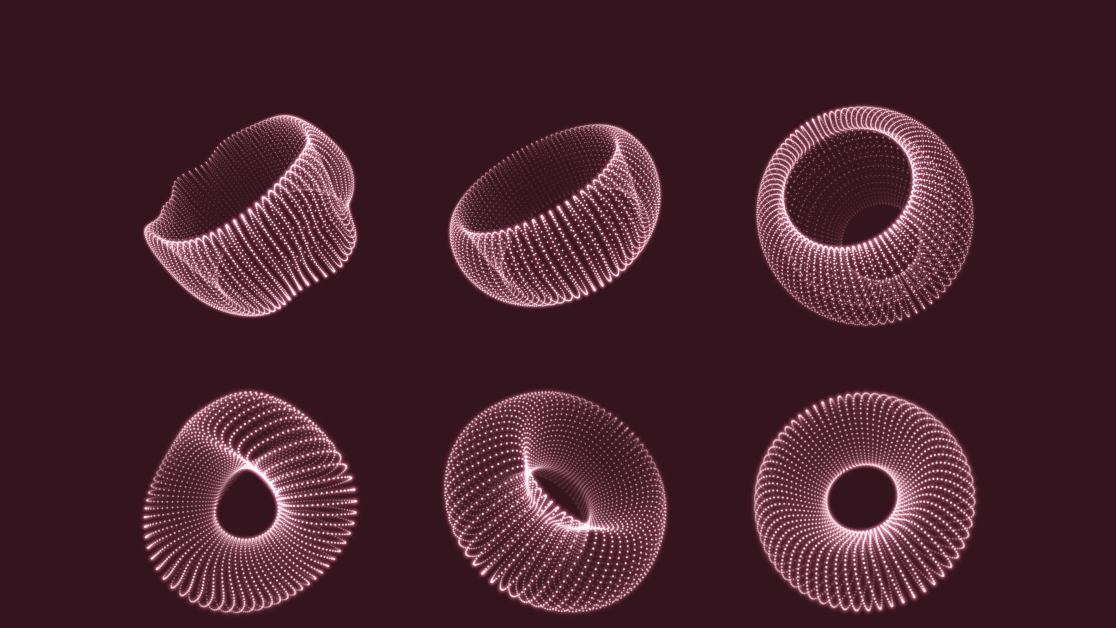
Types of generative models

Slide 11
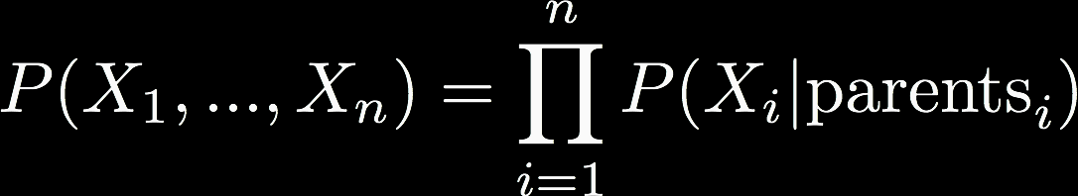
Probabilistic Graphical Models
Arrows represent conditional dependencies between random variables
Structure is used in generative models
Latent generating distribution (hidden)
Observed variables (influenced by latent vars)

Slide 12
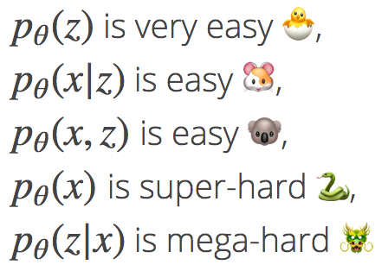
Variational Inference
What is variational inference?
Good for learning latent variable models (i.e., generating distributions of data)
For each observation x we assign a hidden variable z; our model p describes the joint distribution between x and z
Of course these are the things we want to calculate
Inference is p(z|x)
Learning involves p(x)

Slide 13
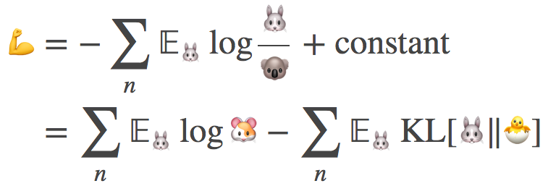
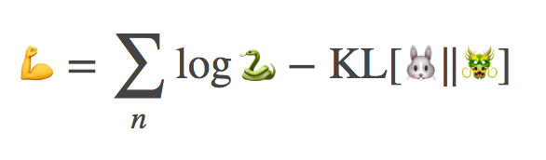
Variational Inference
Rather than learning p(z|x) directly, variational inference approximates with q(z|x)
Maximize the evidence lower bound (ELBO)
This can be written in terms of the “friendly” emojis

Slide 14
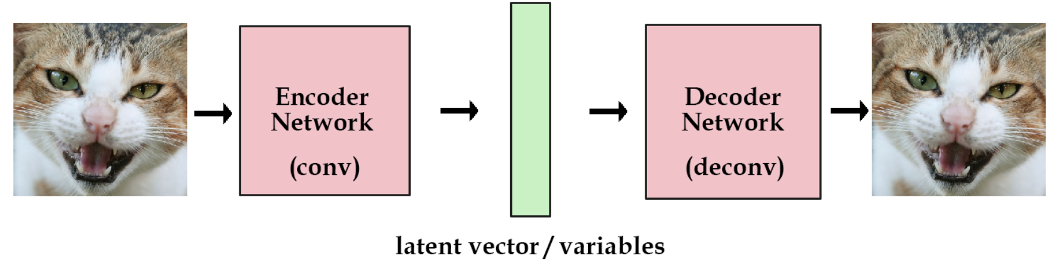
Recall: Autoencoders

Slide 15
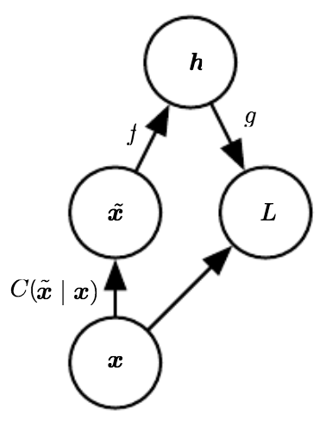

Denoising Autoencoders
Define a corruption process, C
Autoencoder learns a reconstruction distribution $p_{reconstruct}\left(x \right|\tilde{x})$
Sample a training example x
Sample a corrupted version $\tilde{x}$ from C
Use $(x,\tilde{x})$ as a training pair

Slide 16
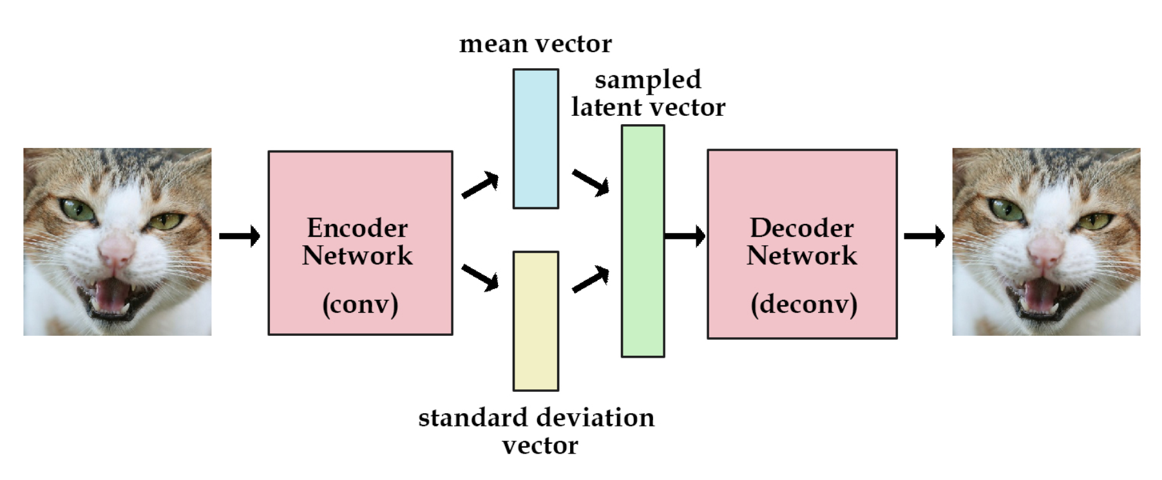
Denoising Autoencoders
De-corruption process results in learning a distribution

Slide 17
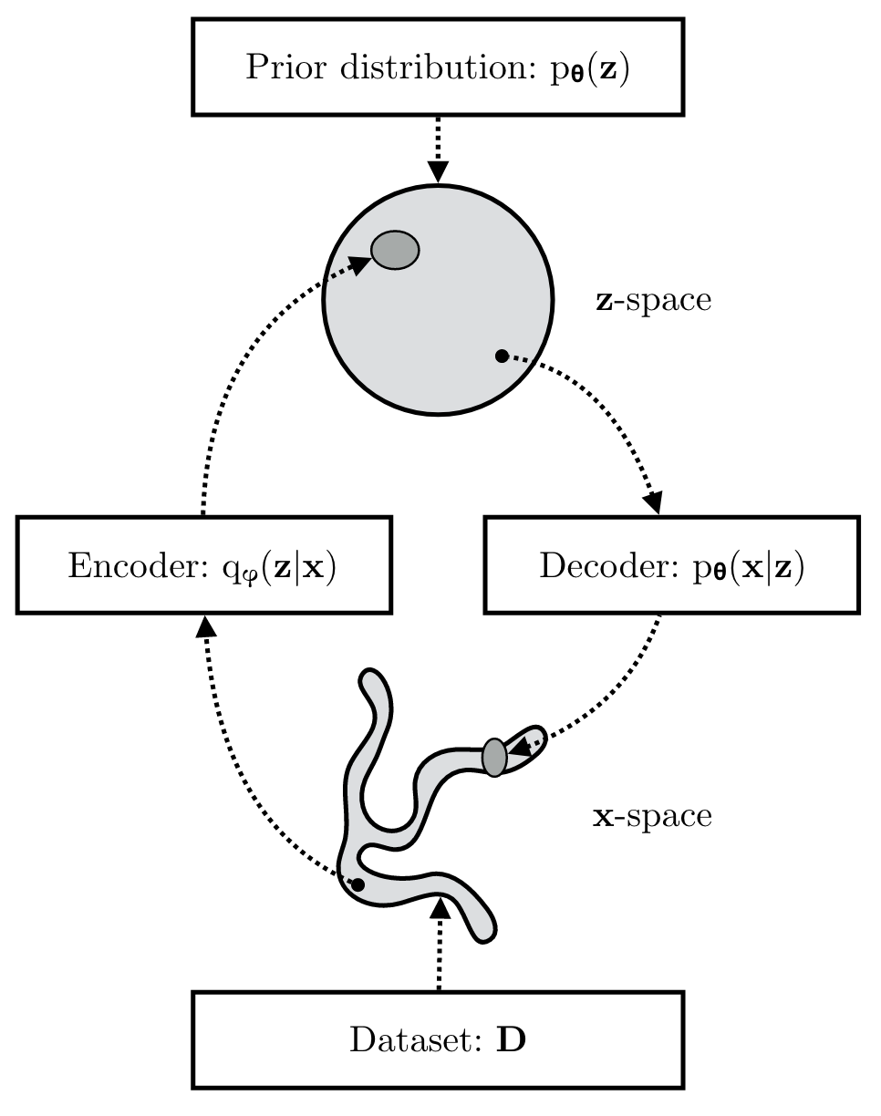
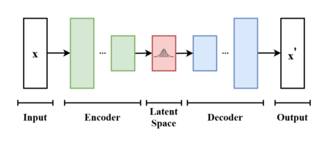
Variational Autoencoders (VAEs)
Associated with autoencoders by virtue of architecture
Goal is to map inputs to latent space
Encoder: Learn parameters of variational distribution, q(z | x)
Decoder: Sample (generate!) from learned distribution to reconstruct input

Slide 18
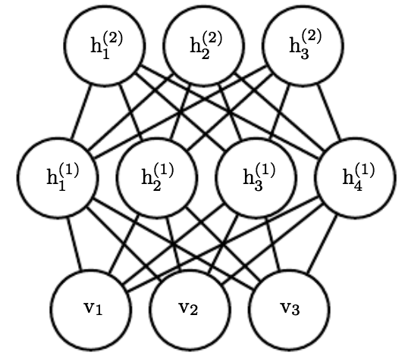
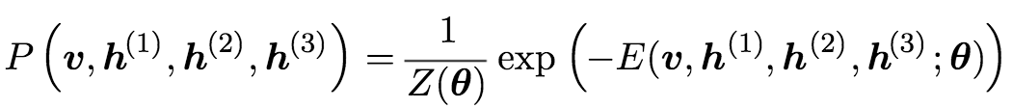
Restricted Boltzmann Machines (RBMs)
Wholly undirected deep network
Implementation of a probabilistic graphical model
Each variable conditionally independent given neighboring nodes
Parameterized by energy function
Sampling from deep RBMs is hard, but training is paradoxically easy

Slide 19
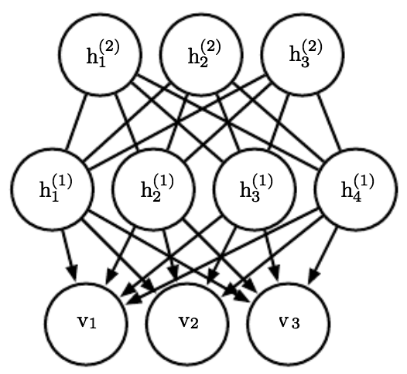
Deep Belief Nets (DBNs)
Connections between layers, but not units within a layer
Arguably one of the first successful applications of modern deep learning
Hinton 2006 and 2007
Often built from an RBM template
Training is nearly intractable
Posterior has to be approximated through annealed importance sampling (AIS)

Slide 20
Generative Adversarial Networks (GANs)

Slide 21
GANs
Game-theoretic approach to generative modeling
Two deep networks: a generator (G) and discriminator (D)

Slide 22
GANs
Generator
Input: a random vector z
Output: something as close to a “real” data point as possible
Discriminator
Input: a ”real” data point OR a synthetic example from G
Output: 1 or 0 (real or fake)

Slide 23
GANs
Minimax “game”
Generator and Discriminator have competing objectives
Goal is to find an equilibrium point
Maximize the Discriminator’s likelihood of identifying a real data example
Minimize the Discriminator’s ability to differentiate real data from Generator examplars

Slide 24
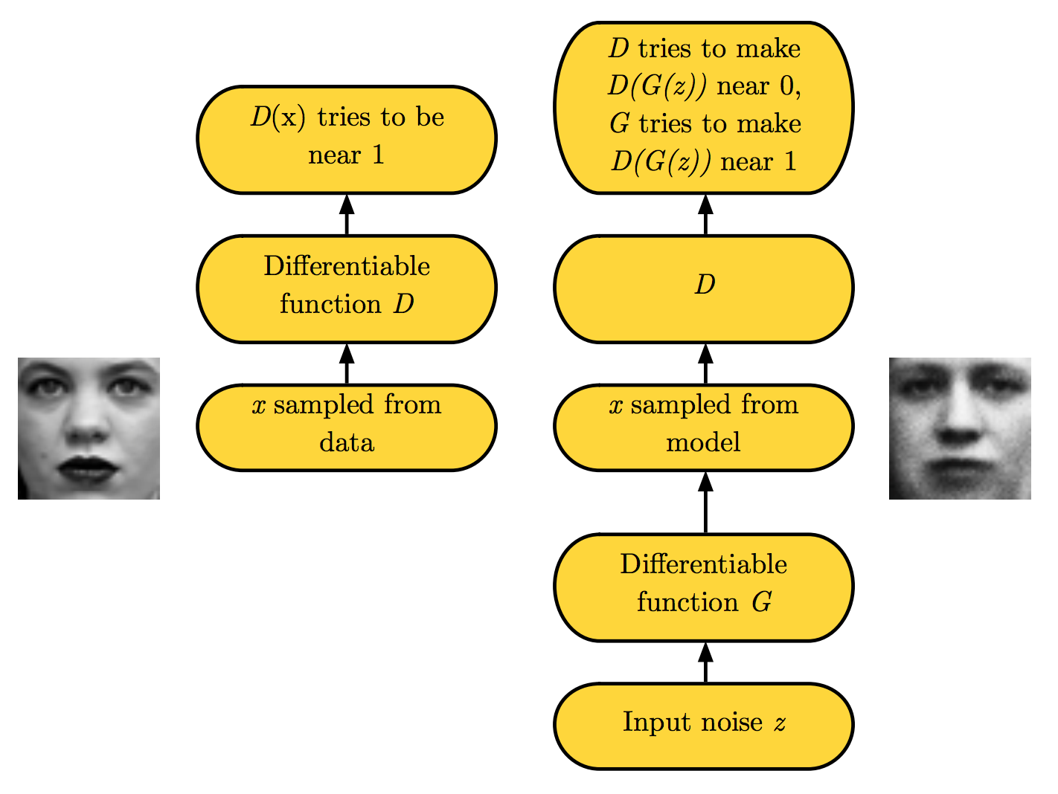
GANs

Slide 25
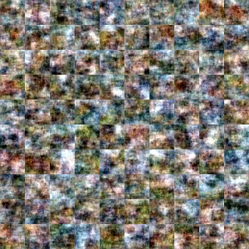
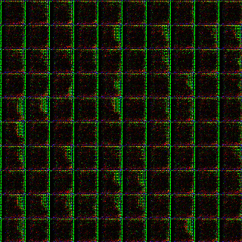
VAEs versus GANs
VAEs
Expectation over learned distribution results in blurring
GANs
Samples from learned distribution, resulting in sharper images
Notes:
VAEs and GANs differ in how they learn their latent spaces
A potential advantage of VAEs over GANs is their explicit latent distributions: they have parameters associated with them and so can interpret those latent distributions. GANs do not; they are “implicit” and can only be sampled from via noise vectors.

Slide 26


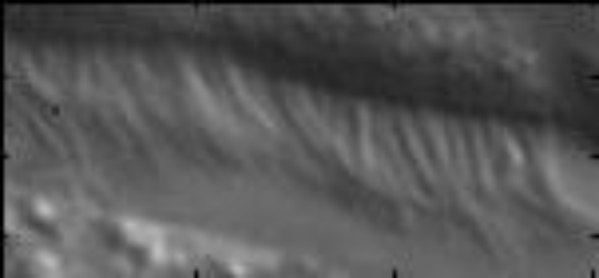
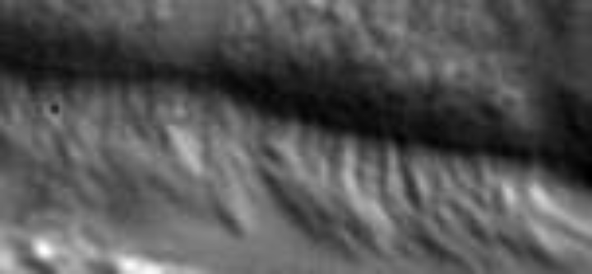
Autoregressive (AR) Models
DALLE-1, in January 2021, was an autoregressive Transformer
Our good friends, Thing 1 and Thing 2 Appearance and State
Once you’ve learned A_{i}, you can generate new x_{t}!
Notes:
Not a high-dimensional AR system—just 5x 2x2!

Slide 27
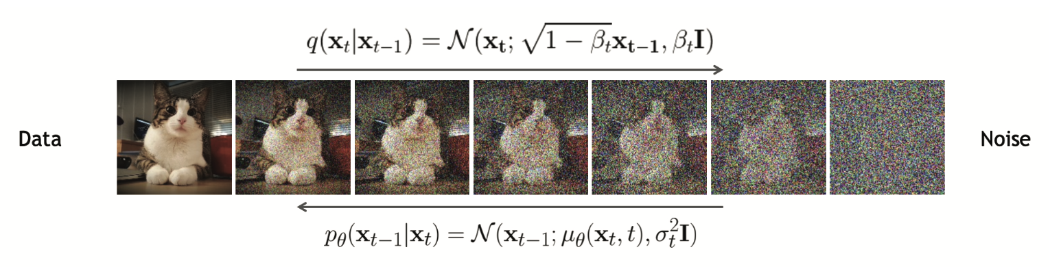
Latent Diffusion
Closely related to VAEs, normalizing flows, and energy-based models
Hard to convert noise into structured data
Easy to convert structured data into noise
Notes:
The forwards diffusion process, q(xt|xt−1), implements the (non-learned) encoder / inference network; this just adds Gaussian noise at each step. The reverse diffusion process, p (xt−1|xt), implements the decoder; this is a learned Gaussian model.

Slide 28
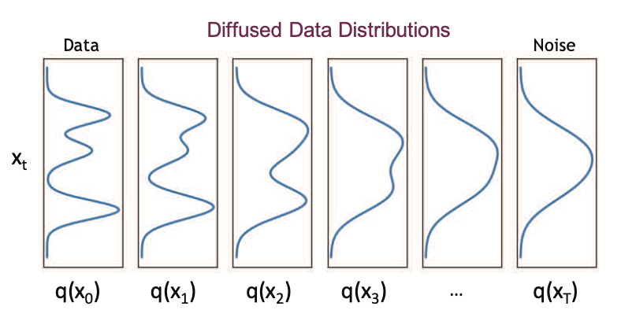
Latent Diffusion
Similar to hierarchical VAE
BUT all latent states have same dimensionality as input
BUT encoder is a linear Gaussian model, rather than being learned
Results in a very simple objective
No risk of posterior collapse (unlike GANs)
Numerous variations of LD
Denoising Diffusion Probabilistic Models (DDPM)
Noise-conditioned Score Networks (NCSN)
Stochastic Differential Equations (SDE)
Notes:
DDPM – initial architecture of LD, uses Markov process to model forward and backward diffusion
NCSN – inspired by physics to sample from large sets of possible particle trajectories (Langevin dynamics)
SDE – assumes continuous diffusion processes, unlike prior two methods, integrating along time

Slide 29
Large Language Models (LLMs)
Not unique generative models per se
LLMs = very, very large Transformers
Usually with autoregressive blocks at inference / decoding
Trained on city blocks’ worth of GPUs
Sometimes called “Foundation Models”
”Foundation Models” are only found on Terminus; elsewhere in the galaxy, they’re just “Sparkling Language Models”

Slide 30
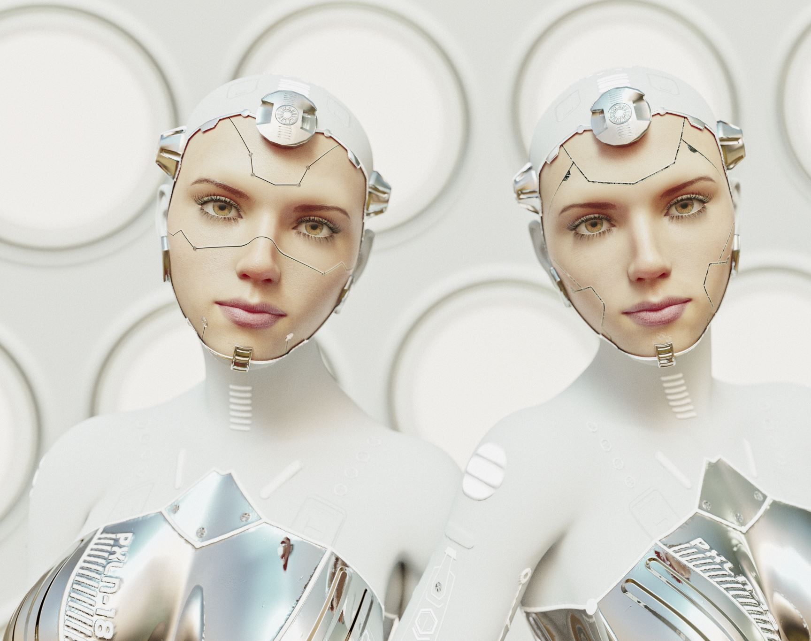
Commercial generative models

Slide 31
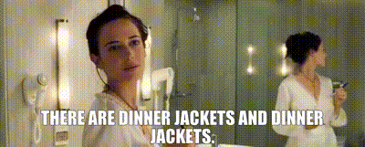
Probably screaming into the void here, but…
There’s AI, and there’s AI
AI
Large language or image models
Trained on massive amounts of data with large numbers of parameters
Does a frighteningly good job of mimicking humans at very specific tasks
Not intelligent
AI
Intelligence that isn’t human but made by humans, aka artificial
Mimics humans very well at all possible tasks, even those it wasn’t trained on
Nowhere in the 5-10 year roadmap

Slide 32

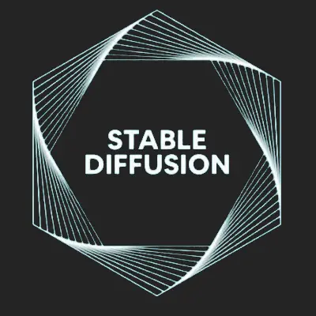


DALL-E, Midjourney, Stable Diffusion, Firefly
Corporate backed text-to-image generators
Subscription fees
Open source options
Training data

Slide 33
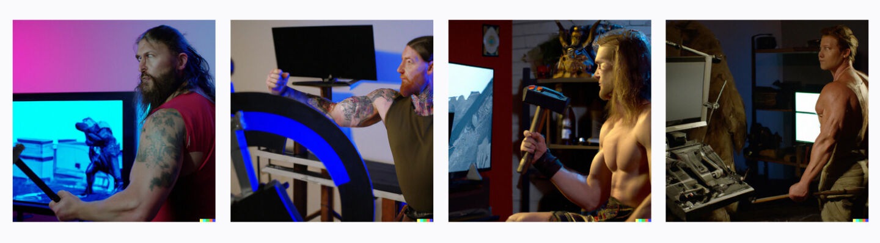

Evolution of Image generators
DALL-E
“a muscular barbarian with weapons beside a CRT television set, cinematic, 8K, studio lighting.”
April 2022
October 2023
https://arstechnica.com/information-technology/2023/11/from-toy-to-tool-dall-e-3-is-a-wake-up-call-for-visual-artists-and-the-rest-of-us/

Slide 34
GPT-4
“Attention is All You Need”, 2017
Powers ChatGPT
A “Transformer-style model pre-trained to predict the next token in a document, using both publicly available data (such as internet data) and data licensed from third-party providers.”
“The model was then fine-tuned using Reinforcement Learning from Human Feedback (RLHF).”
Several thousand GPUs + petabytes of data = ChatGPT
“Deep reinforcement learning from human preferences”, 2017

Slide 35
PaLM, Cerebras, LLaMA, Falcon, OpenHermes
Similar underlying architecture to ChatGPT
Billions (to trillions?) of parameters
GPT-4 rumored to have ~2T parameters (source: SoC Day keynote speaker)
Billions to trillions of training tokens
PaLM 2 and LLaMA 2: 3.6T and 2T, respectively
Varying levels of openness
Some pre-trained models on Huggingface
An open LLM + RLHF (reinforcement learning from human feedback) + RLAIF (reinforcement learning from AI feedback) + DPO (direct preference optimization) = best bang for buck, outside of ChatGPT or similar

Slide 36
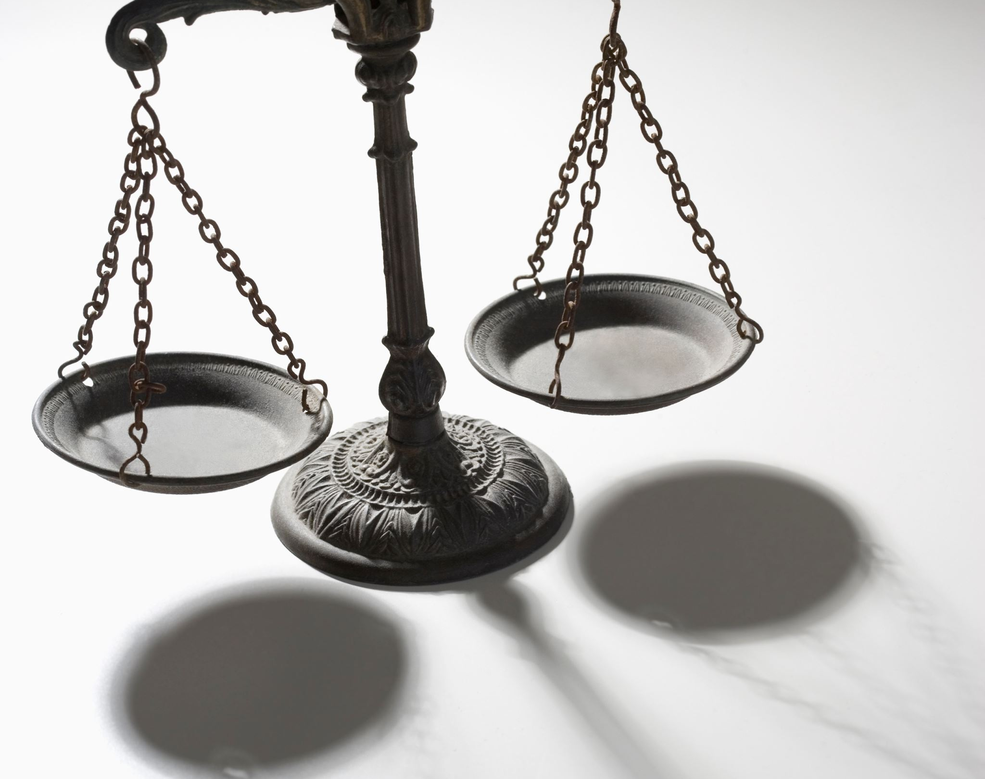
Technical, Ethical, and Legal Considerations

Slide 37
This is not unique to Generative AI
Recall our Sept 19 lecture on Ethics in AI/ML: we should always be considering the ethical and legal ramifications of our work
But: given how widely available and easily accessed tools like ChatGPT are, and the hype surrounding them
There’s never been a better time to have these conversations

Slide 38
Advantages of Generative AI
Already legion!
Democratize access to art and figure generation
Interactive, natural-language interfaces
As opposed to arcane tricks and query optimization hacks with traditional search engines
Revealed clear weaknesses in our assessment protocols
Educational assessment (i.e., grading) should not be contingent on whether or not you had access to a chatbot

Slide 39
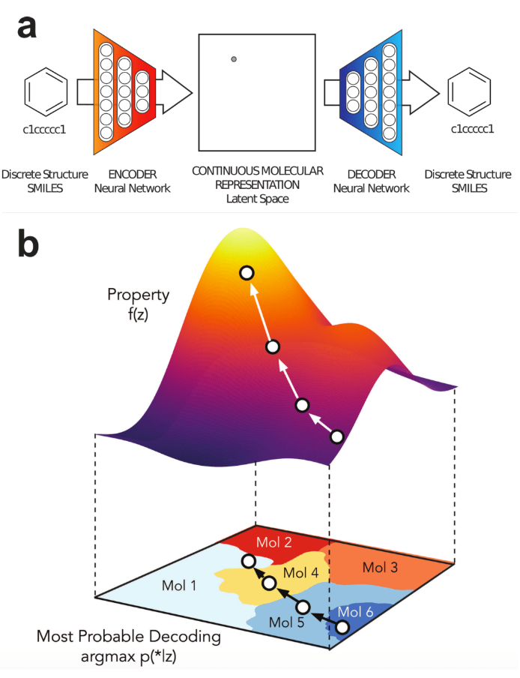
Advantages of Generative AI
New scientific discoveries around medicine, biology, chemistry, and biochemistry
Design new compounds (drugs, antibiotics, treatments) by teaching generative models about known ones
Keynote speaker at IOB Symposium in October spoke about using LLMs to discover new proteins!
Notes:
Application of a VAE to chemical design in (Gómez-Bombarelli et al., 2018). A latent continuous representation z of molecules is learned on a large dataset of molecules.
This continuous representation enables gradient-based search of new molecules that maximizes f (z), a certain desired property.

Slide 40
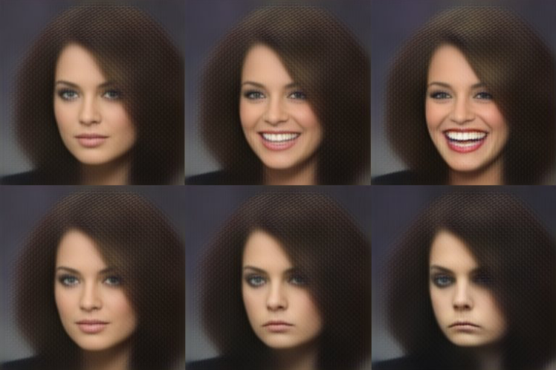
Advantages of Generative AI
Accessibility and interactivity
Original image (top left) interpolated along VAE latent distribution, producing different facial expressions
Virtual avatars, assistants, video gaming
Notes:
VAEs can be used for image resynthesis. In this example by White, 2016, an original image (left) is modified in a latent space in the direction of a smile vector, producing a range of versions of the original, from smiling to sadness.

Slide 41
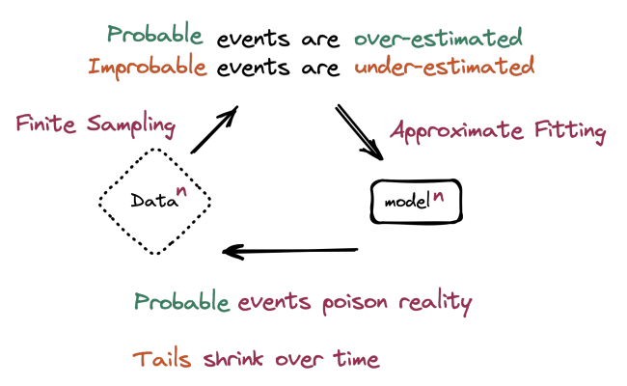
Technical issues
Recursive model training
As more information on the internet (images, text) is AI-generated, LLMs will ingest this data as part of their training, creating a recursive training loop
“The Curse of Recursion: Training on Generated Data Makes Models Forget”
https://arxiv.org/abs/2305.17493

Slide 42
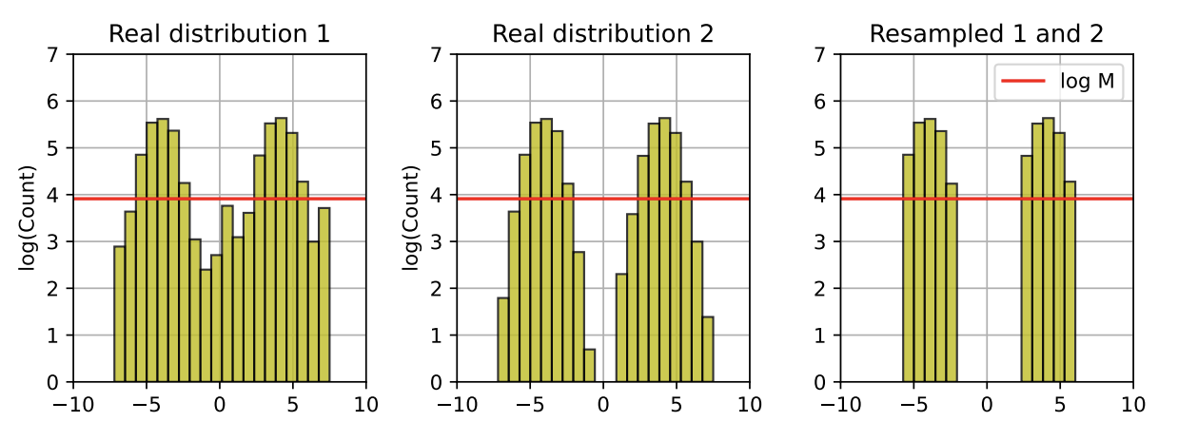
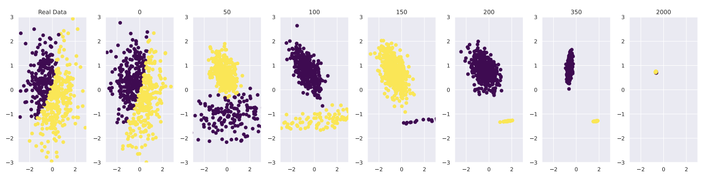
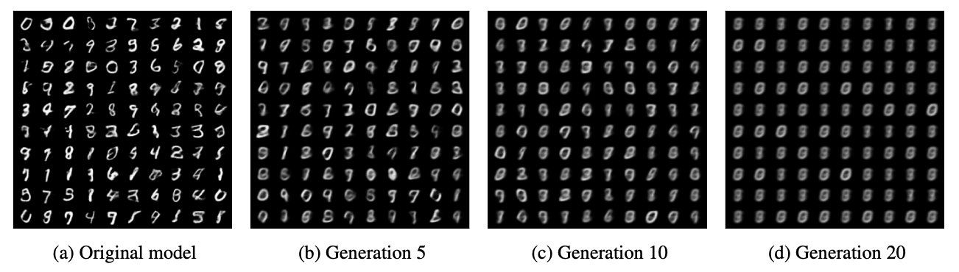
Technical issues
Examples of recursive model training

Slide 43
Legal issues
Copyright
OpenAI, Midjourney most likely training on image datasets without permission from authors
Currently in the US, AI-generated art cannot be copyrighted → potential boon for public domain!
Plagiarism
Simply: if you didn’t write/code/create it yourself, and you didn’t otherwise specify where it came from (and sometimes, even if you did), it’s plagiarism
Is getting the answer from ChatGPT and presenting it as your own any different from getting the answer from your classmate and presenting it as your own?
Huge implications in professional fields, given current chatbot accuracy levels

Slide 44
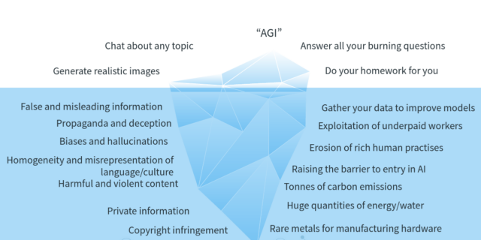
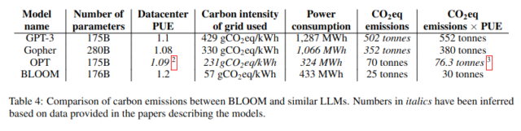
Ethical and moral issues
Disinformation
Enabling/scaling abuse
Environmental concerns
Worker exploitation
Hidden costs of AI
Notes:
Disinformation: as simple as fraudulent product reviews, as serious as propaganda
500 metric tons = 1M miles drive by gasoline-powered car

Slide 45
Philosophical issues
Novelty
Is the content generated from ChatGPT / Midjourney new?
The “tool” analogy
Generative AI is inherently neither good nor bad, but dependent on its application
In 1999, French cultural theorist Paul Virilio wrote, "When you invent the ship, you also invent the shipwreck; when you invent the plane you also invent the plane crash; and when you invent electricity, you invent electrocution... Every technology carries its own negativity, which is invented at the same time as technical progress."
Notes:
“CAN be used for good OR bad things” is not the same as “WILL be used for good AND bad things”
The real question: will the good things outweigh the bad things? Can we minimize the bad things and encourage the good things?

Slide 46
I don’t have answers

Slide 47
Conclusions
Generative modeling
Learn a distribution instead of a decision boundary
Can still be used for classification
Usually requires more data than discriminative models
Deep generative modeling
DBNs, RBMs, Denoising & Variational Autoencoders, GANs, AR models, LD
All ways of learning a generating distribution from data in deep neural architectures
Deployments of generative AI
Commercial products (ChatGPT, Stable Diffusion, Midjourney, DALL-E)
Possibilities, advantages, moral/ethical/legal/philosophical considerations
Consider the possible use-cases

Slide 48
References
“Generative Learning algorithms”, CS 229 notes by Andrew Ng http://cs229.stanford.edu/notes/cs229-notes2.pdf
Andrew Ng and Michael I. Jordan (!!!), “On Discriminative vs. Generative classifiers: A comparison of logistic regression and naive Bayes” (NIPS 2002) http://papers.nips.cc/paper/2020-on-discriminative-vs-generative-classifiers-a-comparison-of-logistic-regression-and-naive-bayes.pdf
“Generative versus Discriminative”, Cross-Validated https://stats.stackexchange.com/questions/12421/generative-vs-discriminative/223850
“Generative Adversarial Networks”, NIPS 2016 Tutorial https://arxiv.org/pdf/1701.00160.pdf
Variational Inference http://www.inference.vc/choice-of-recognition-models-in-vaes-a-regularisation-view/
Tutorial on Variational Autoencoders https://arxiv.org/abs/1606.05908
“Progressive Growing of GANs for Improved Quality, Stability, and Variation”, https://arxiv.org/abs/1710.10196
“Generative Adversarial Networks (GANs), Some Open Questions”, http://www.offconvex.org/2017/03/15/GANs/
“GANs are Broken in More than One Way: The Numerics of GANs”, http://www.inference.vc/my-notes-on-the-numerics-of-gans/
“Diffusion Models in Vision: A Survey”, https://ieeexplore.ieee.org/iel7/34/4359286/10081412.pdf
“GPT-4 Technical Report”, https://arxiv.org/abs/2303.08774
“Deep reinforcement learning from human preferences”, https://proceedings.neurips.cc/paper_files/paper/2017/file/d5e2c0adad503c91f91df240d0cd4e49-Paper.pdf
"An introduction to variational autoencoders”, https://www.nowpublishers.com/article/DownloadSummary/MAL-056
“Probabilistic Machine Learning, Advanced Topics”, Kevin Murphy. Part IV: Generation. https://probml.github.io/pml-book/book2.html

Slide 49
Administrivia
Homework 5 due by the end of the day TODAY
Happy Thanksgiving holiday!
Final Project Presentations start next Monday (and continue through next Tuesday, Thursday, and the following Monday)
Presentations for the day are randomly assigned at the start of each day
12 minutes + 3 minutes for Q&A
Please attend and support your classmates even after you’ve given your talks—they worked hard, too!
If you need a specific time slot contact me ASAP
Course evaluations—please fill them out!
eval.franklin.uga.edu

Slide 51
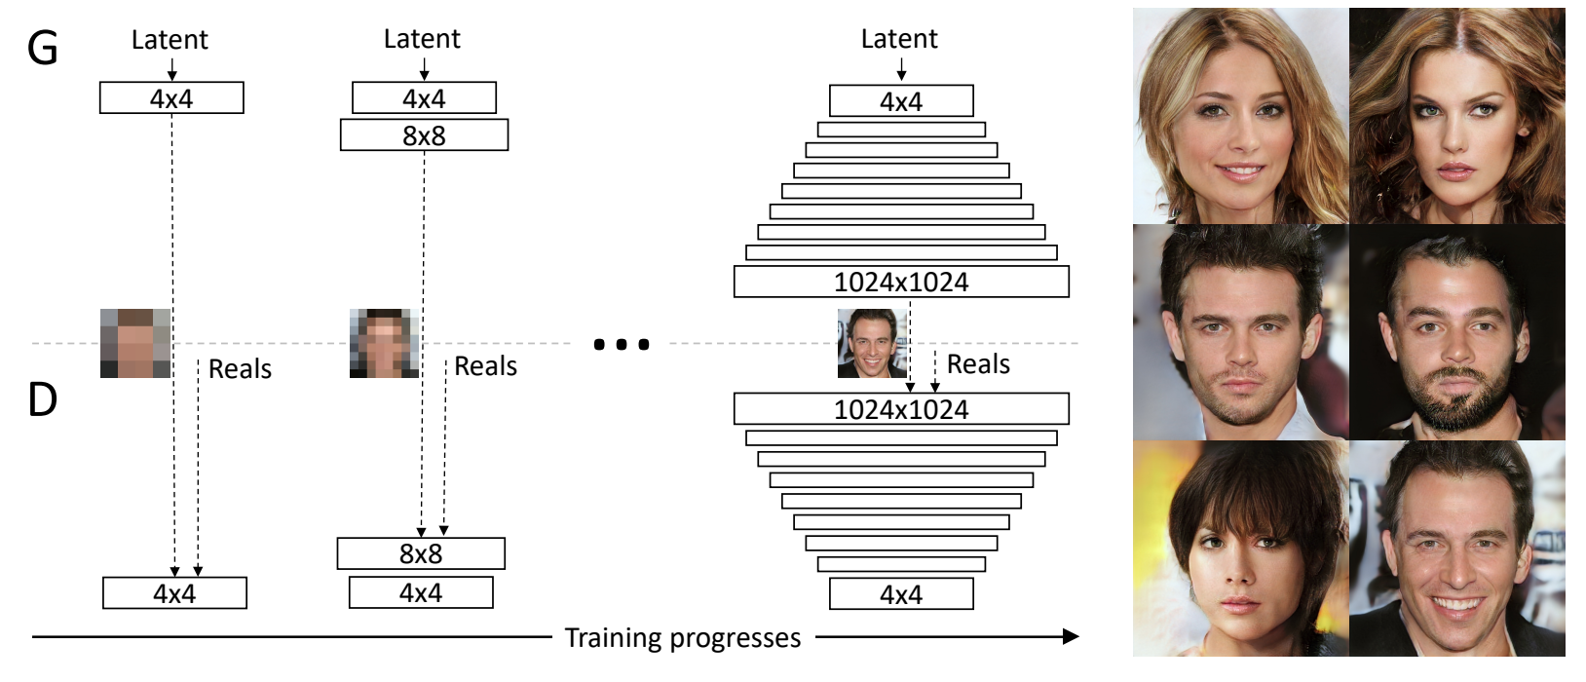
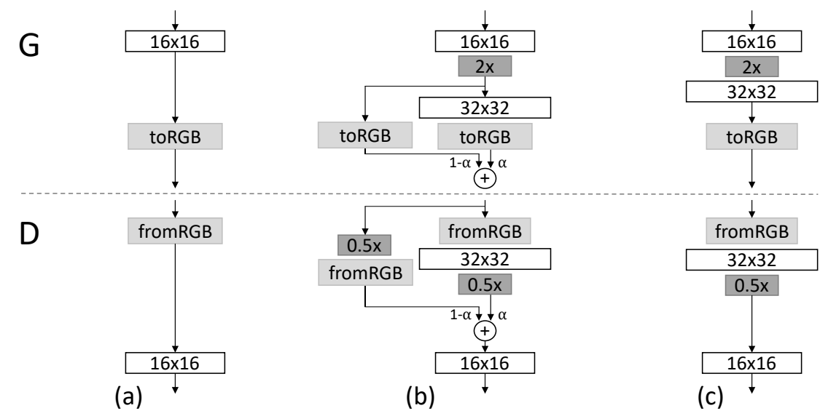
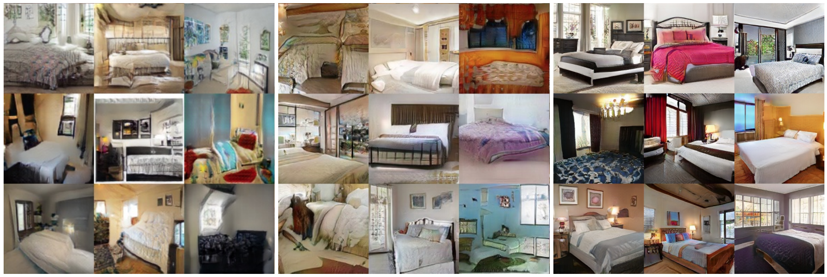
GAN Advances
Progressively grow the GAN subspace over training
Notes:
All generated images!
Treat images from previous training rounds as residuals

Slide 52
GAN Advances
Wasserstein objective function
“Earth-mover” distance W(q, p)
Minimum cost of transporting mass in order to transform distribution q into the distribution p (where cost is mass x distance)
Gradient is much better behaved than Jenson-Shannon objective (KL-divergence based)
Weights are clipped at [-c, c]
Takes a lot longer to train on average
Notes:
Capacity is still heavily restricted from what it should be
Problems with vanishing and exploding gradients during training due to weight clipping

Slide 53
GAN Advances
Improved Wasserstein
Introduces a gradient penalty on the discriminator output with respect to its input
Instead of hard clipping gradient weights, soft[max] penalties are used
P_{r} is the distribution of real data, P_{g} is from the generator, and P_{x} is defined from sampling uniformly along straight lines between pairs of points sampled from P_{r} and P_{g}
Original** WGAN objective
Two-sided gradient penalty on Discriminator
Notes:
This is motivated by the fact that the graph of the optimal critic consists of straight lines connecting points from Pr and Pg.
Given that enforcing the unit gradient norm constraint everywhere is intractable, enforcing it only along these straight lines seems sufficient and experimentally results in good performance

Slide 54
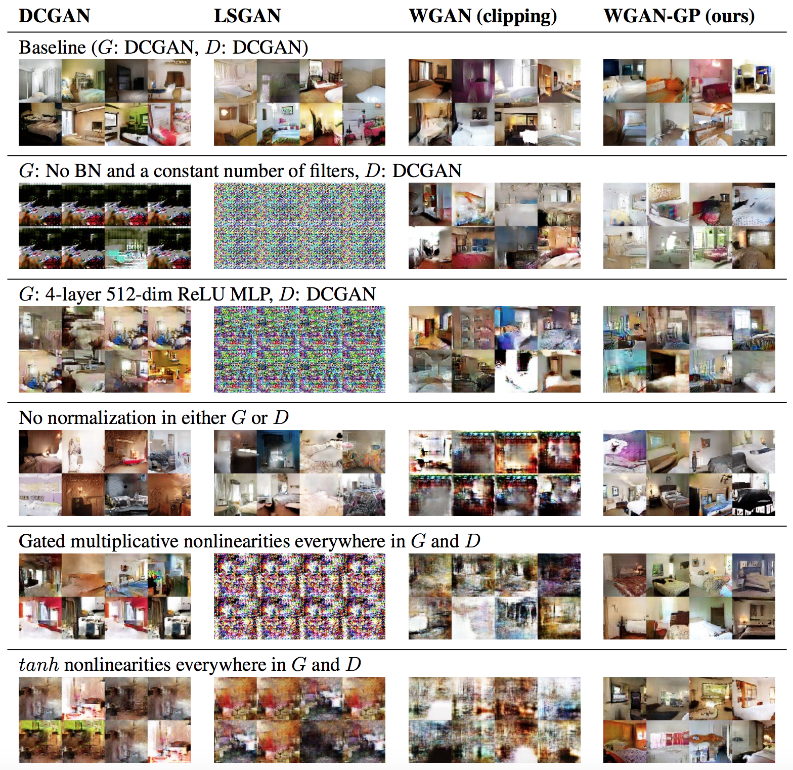

Slide 55
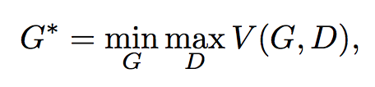
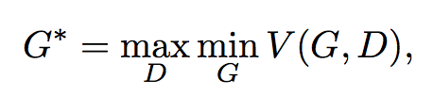
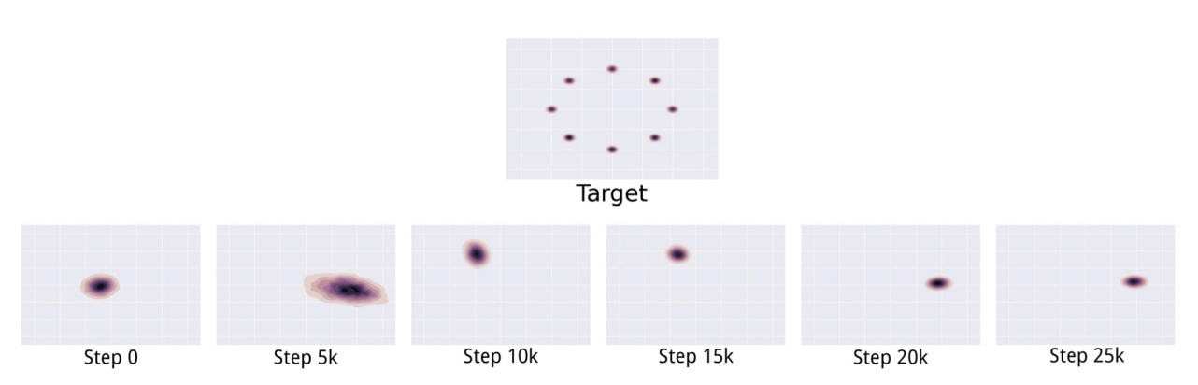
Open Questions with GANs
Mode collapse
The “Helvetica Scenario”
Maps several different inputs z to the same output
Full collapse is rare, but partial collapse is common
Notes:
the minimization with respect to the generator now lies in the inner loop of the optimization procedure. The generator is thus asked to map every z value to the single x coordinate that the discriminator believes is most likely to be real rather than fake. Simultaneous gradient descent does not clearly privilege min max over max min or vice versa. We use it in the hope that it will behave like min max but it often behaves like max min.
Does not seem to be caused by any particular loss function

Slide 56
Open Questions with GANs
Evaluation of GANs
(not specific to GANs per se, but generative models)
Models that obtain good likelihoods can generate bad samples
Models that generate good samples can have poor likelihoods
Also difficult to evaluate likelihood with GANs

Slide 57
Open Questions with GANs
Goal is to find Nash equilibrium
Problem 1: Does it exist?
No conclusive way to show this
Problem 2: If it exists, can we find it?
Inability to find equilibrium can be cause of oscillatory behavior in training
…or a sign that equilibrium doesn’t exist?
Problem 3: More than finding equilibrium, can generator win?
Intuitively: to learn as representative a generator as possible, discriminator should be utterly unable to differentiate between real and fake

Slide 58
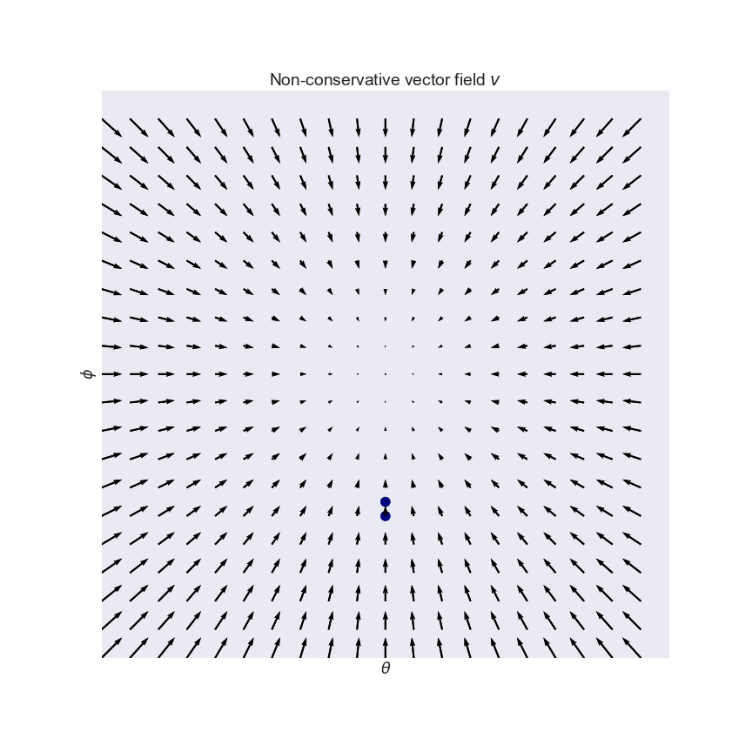
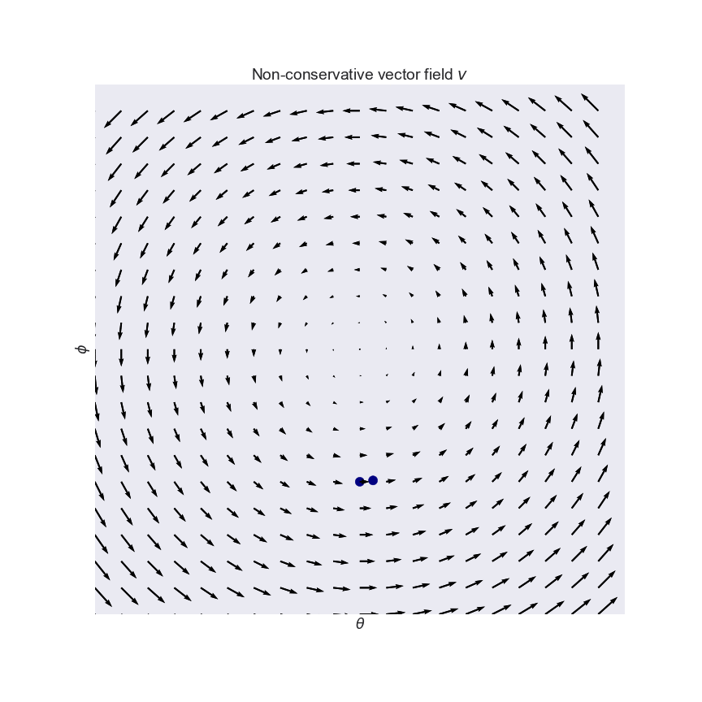
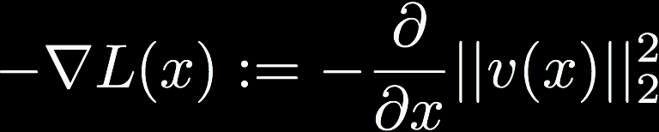
Training a GAN
GANs use a variant of SGD called simultaneous gradient descent
Key difference: the latter gives rise to non-conservative vector fields
Like Escher’s staircase
Solution: convert to conservative vector field
New problem: can’t differentiate between saddle points or equilibria, or negative or positive equilibria

Slide 59
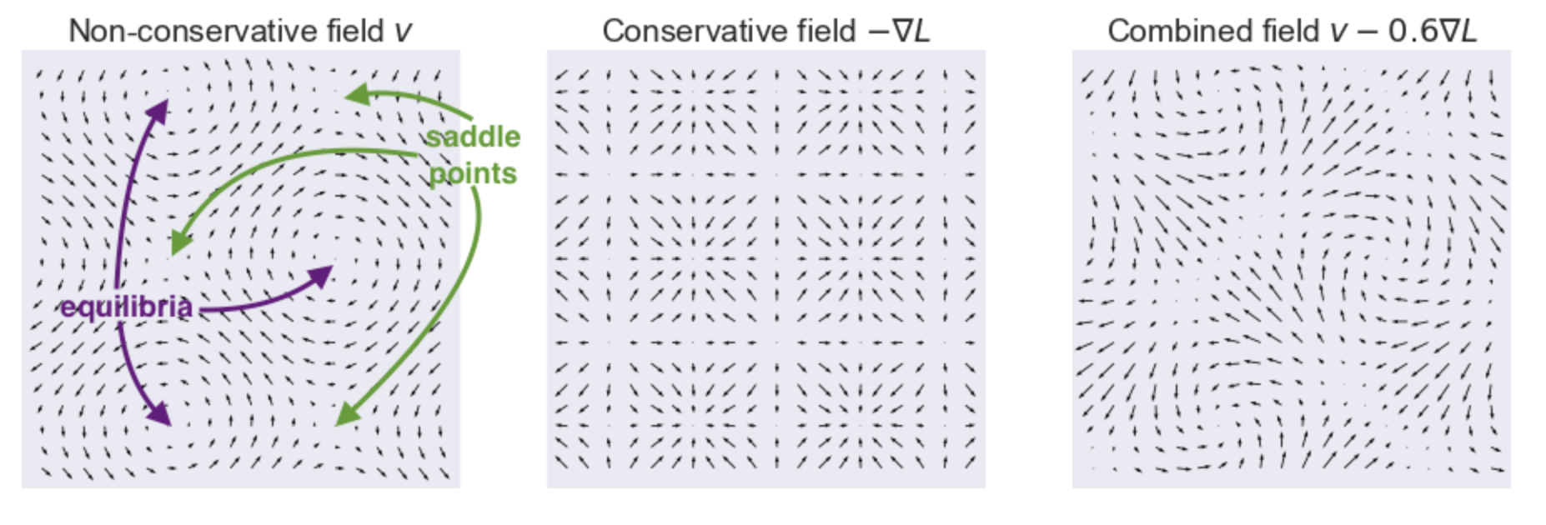
Training a GAN
Notes:
On the left-hand plot I annotated equilibria and saddle points.
The middle plot shows the conservative relaxation −∇L−∇L where both saddle points and equilibria are turned to local minima.
So what can we do? We can simply take a linear combination of the original vv and it's conservative cousin −∇L−∇L. This is what the combined (still non-conservative) vector field looks like for the curl field (see also the third panel of the figure above):

Slide 60
Open Questions with GANs
Exploration of the learned manifold
Advantage of GANs: no a priori assumptions on the underlying form of the generating distribution
Disadvantage of GANs: no way to meaningfully interpret the resulting learned generating distribution
Manifold walking, interpolation, image algebra, INFO-GANs

